Slide 1
Object Oriented Programming

Slide 2
Primitives & Wrappers
Java has a wrapper class for each of the eight primitive data types:
Primitive Type | Wrapper Class |  | Primitive Type | Wrapper Class
boolean | Boolean |  | float | Float
byte | Byte |  | int | Integer
char | Character |  | long | Long
double | Double |  | short | Short
3/24/2008

Slide 3
float is not Float
Consider
float x;
Float y;
What is the difference between x & y?

Slide 4
Primitives & Wrapper Classes
float x;
Float y;
x = 2.7f; // ok
y = 2.7f; // ERROR, why?
y is a reference (currently NULL)
y can refer to a Float object
There are 3 constructors

Slide 5
Wrapper class
float x;
Float y;
y = new Float(2.7f); // OK
y = new Float(2.7); // OK
y = new Float(“2.7”); // OK
A wrapper class provides conversion functionality; useful in data structures, sorting objects, etc.

Slide 6
float is not Float
float x = 2.7f;
Float y = new Float(“2.7”);
What is the difference between x & y?
x is a primitive; can’t send a message to x
y refers to an object; responds to any message appropriate for Float

Slide 7
Wrapper class methods
What do the following methods do?
Integer.parseInt(“42”)
Integer.valueOf(“42”)
Notes:
the parseInt method in the Integer class to parse a numeric string into an int value
the parseDouble method in the Double class to parse a numeric string into a double value
The numeric wrapper classes have a useful class method, valueOf(String s). This method creates a new object initialized to the value represented by the specified string

Slide 8
Wrapper class methods
Each numeric wrapper class implements the abstract methods doubleValue, floatValue, intValue, longValue, and shortValue.
These methods “convert” objects into primitive type values.

Slide 9
Operations Determined by Type of Reference Variable
Variable can refer to object whose type is a subclass of the variable’s declared type
Object
Integer

Slide 10
Operations Determined by Type of Reference Variable
Object obj;
Integer intgr = new Integer(25);
obj = intgr;
intgr = obj; //Error
  Compiler always verifies that variable’s type
  includes the class of every expression assigned to the variable

Slide 11
Operations Determined by Type of Reference Variable
Type of the variable determines what operations are legal
obj.intValue() //Error
Even though the actual object pointed to is an Integer

Slide 12
Casting in a Class Hierarchy
Casting obtains a reference of different, but matching, type
Casting does not change the object!
  It creates an anonymous reference to the object
Integer aInt = (Integer)obj;
Now we can use aInt as an Integer object

Slide 13
Casting in a Class Hierarchy
Downcast:
Needs to be done explicitly
  Cast superclass type to subclass type
  Checks at run time to make sure it’s ok
  If not ok, throws ClassCastException

Slide 14
Casting in a Class Hierarchy
You can verify by using instanceOf
  if (obj instanceOf Integer) {
  // obj is an Integer; cast
  Integer aInt = (Integer)obj;
  } else
  {
  // obj is not an Integer; error
  …;
  }
instanceof can guard against ClassCastException

Slide 15
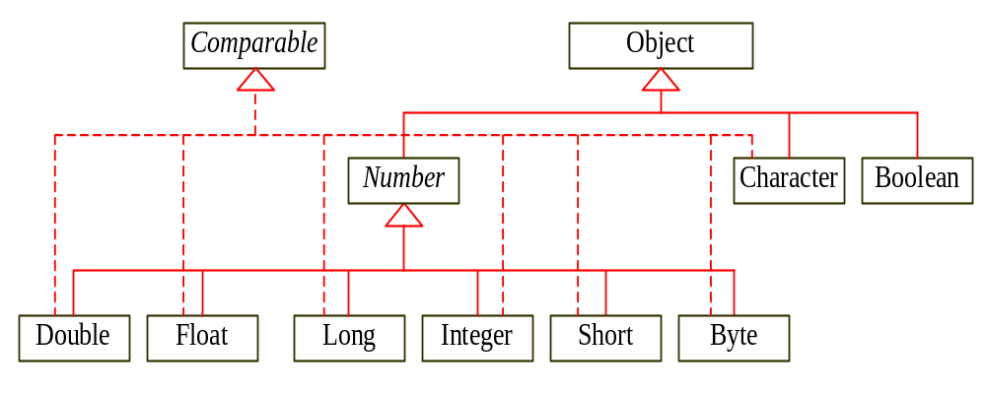
Wrapper Classes
Boolean
Character
Short
Byte
NOTE: (1) The wrapper classes do not have no-arg constructors. (2) The instances of all wrapper classes are immutable, i.e., their internal values cannot be changed once the objects are created.
Integer
Long
Float
Double

Slide 16
The Method Object.equals
Object.equals method has parameter of type Object
public boolean equals (Object other) { ... }
Compares two objects to determine if they are equal
Must override equals in order to support comparison

Slide 17
equals method
  public boolean equals(Object obj) {
  if (obj instanceof Integer) {
  // o is an Integer; cast and compare it
  Integer aint = (Integer) obj;
  return this.intValue() ==
  aint.intValue();
  } else {
  // o is not an Integer; cannot
  be equal
  return false;
  }
  }

Slide 18
Circle class & Point class
files: Circle.java
Point.java
A separate test program
TestCircle.java

Slide 19
public class Circle {
/* private implementation (instance variables) */
private float radius;
private Point center;
/** constructor: given radius and 2 ints*/
public Circle(float aRadius, int x, int y) { /* implementation */ }
/** accessor method */
public float getRadius() { return radius; }
/** mutator method */
public void setRadius(float newRadius) { radius = newRadius;}
/** accessor method */
public Point getCenter() { return center; }
/** method which computes and returns the area of the circle */
public float computeArea() { /* implementation */ }
}

Slide 20
Circle class
public class Circle {
private float radius;
private Point center;
/** constructs a circle with given radius & center */
public Circle(float radius, int x, int y)
{
this.radius = radius;
this.center = new Point(x, y);
}

Slide 21
“Overloading” methods
multiple versions of a method, distinguished by their “signatures” (name & argument list)
it is very common to overload constructors
example:
public Circle(int x, int y) // creates unit circle
public Circle(float radius, int x, inty)

Slide 22
toString() method
c1 = new Circle(1.5f, 0, 0);
System.out.println( c1 );
c1.toString() is automatically called
Prints Circle@1afa3 !!

Slide 23
Overriding toString
public class Circle
{ …
public String toString()
{
return “\n \t center: [“ +
center.getX() + “,” +
center.getY() + “]” +
“ \n \t radius: “ + radius;
}

Slide 24
public class Circle
{
public String toString()
{
return “\t center: “ + center +
“\n \t radius: “ + radius;
} // alternative implementation
// other methods
}
counts on the Point class overriding toString()

Slide 25
Circle c1 = new Circle(1.5f, 10, 20);
System.out.println( c1 );
prints
center: <10,20>
radius: 1.5

Slide 26
Relationships between classes
public class Circle {
private float radius;
private Point center;
A Circle “has a” Point
UML Class Diagram
HAS-A
1
Circle
Point
FilledCircle
(composition)

Slide 27
Relationships between classes
Object
A Circle “is an” Object
IS-A
(inheritance)
public class Circle { /* … */ }
(everything is an Object, except for a primitive value)
Circle
UML Class Diagram

Slide 28
Relationships
composition “has-a” relationship
inheritance “is-a” relationship

Slide 29
Relationships between classes
public class Circle { /* stuff */ }
public class FilledCircle
extends Circle {
Circle
IS-A
(inheritance)
FilledCircle
A FilledCircle “is a” Circle
UML Class Diagram

Slide 30
Circle.java
public class Circle {
private float radius;
private Point center;
/* constructors, getRadius(), setRadius(),
getCenter(), computeArea() */
}
/* want to create a subclass of Circle, namely FilledCircle */

Slide 31
Recall: Uses of “this”
this reference to “current object”
this.radius
this() way to “call” another constructor in the
same class

Slide 32
Uses of “super”
super reference to the superclass
super.radius // caution: inaccessible
super() way to “call” a constructor for the superclass
public FilledCircle(float radius, int x, int y) {
super(radius, x, y);
}

Slide 33
FilledCircle.java
import java.awt.Color;
public class FilledCircle extends Circle
{ private Color fillColor = Color.black;
public FilledCircle (float radius, int x, int y) {
super(radius, x, y);
}
public FilledCircle (
float radius, int x, int y, Color newFillColor) {
super(radius, x, y);
fillColor = newFillColor;
}
….}

Slide 34
UML class diagram
Object
IS-A
IS-A
HAS-A
1
Circle
Point
(composition)
IS-A
(inheritance)
FilledCircle

Slide 35
Inheritance
A subclass inherits all instance variables and all methods from its superclasses
e.g. FilledCircle inherits radius and center from Circle along with the methods getRadius(), setRadius(), computeArea(), etc.

Slide 36
Access modifiers
“default” is package
access modifiers:
- public
- private
- protected
- none (defaults to “package” access)

Slide 37
So FilledCircle can’t directly manipulate radius or center (only Circle can)
public – everyone can use it
private – only within the class
protected – subclasses have access
package – everyone in same package

Slide 38
Overloading
multiple versions of a method, distinguished by their “signatures”
(name and argument list)
Overriding
when a subclass completely replaces a method that it inherits from its superclass (same signature)

Slide 39
Object
IS-A
IS-A
Circle
HAS-A
1
Point
IS-A
FilledCircle

Slide 40
methods: toString(), equals(), getClass(), …
Object
methods: constructors, get/setCenter(), get/setRadius(),
computeArea()
toString()
Circle
methods: constructors, get/setColor()
toString()
FilledCircle

Slide 41
public class FilledCircle
extends Circle
{
private Color fillColor = Color.black;
public String toString()
{
return super.toString() +
“\n \t color: “ + fillColor;
}
// other methods for the class
}

Slide 42
Circle c1 = new Circle(1.5f, 10, 20);
FilledCircle fc1 =
new FilledCircle(2.0f, 1, 1, Color.cyan);
System.out.println( c1 );
System.out.println( fc1 );
center: <10,20>
radius: 1.5
center: <1,1>
radius: 2.0
color: java.awt.Color[r=0,g=255,b=255]

